Slide 1
Web Developement
Unit No 4: JSP and Web Services [8 Hours]
JSP: Introduction to Java Server Pages, JSP and Servlets, running JSP applications, Basic JSP, JavaBeans classes and JSP, Support for the Model-View-Controller paradigm, JSP related technologies. Web Services: Web Service concepts, writing a Java Web Service, Writing a Java web service client, Describing Web Services: WSDL, Communicating Object data: SOAP. Struts: Overview, architecture, configuration, actions, interceptors, result types, validations, localization, exception handling, annotations.

Slide 2
Web Developement
JSP JavaServer Pages (JSP):
-JSP is a technology for developing Webpages that supports dynamic content.
- It can be thought of as an extension to Servlet because it provides more functionality than servlet such as expression language, JSTL, etc.
-This helps developers insert java code in HTML pages by making use of special JSP tags, most of which start with <% and end with %>.
-A JSP page consists of HTML tags and JSP tags.
-The JSP pages are easier to maintain than Servlet because we can separate designing and development. -It provides some additional features such as Expression Language, Custom Tags, etc.

Slide 3
Web Developement
Unit No 4: JSP and Web Services [8 Hours]
Advantages of JSP over Servlet
There are many advantages of JSP over the Servlet. They are as follows:
1) Extension to Servlet
JSP technology is the extension to Servlet technology. We can use all the features of the Servlet in JSP. In addition to, we can use implicit objects, predefined tags, expression language and Custom tags in JSP, that makes JSP development easy.
2) Easy to maintain
JSP can be easily managed because we can easily separate our business logic with presentation logic. In Servlet technology, we mix our business logic with the presentation logic.

Slide 4
Web Developement
3) Fast Development: No need to recompile and redeploy
If JSP page is modified, we don't need to recompile and redeploy the project. The Servlet code needs to be updated and recompiled if we have to change the look and feel of the application.
4) Less code than Servlet
In JSP, we can use many tags such as action tags, JSTL, custom tags, etc. that reduces the code. Moreover, we can use EL, implicit objects, etc.

Slide 5
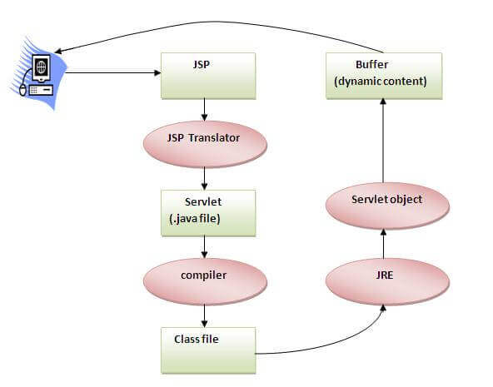
Web Developement
The Lifecycle of a JSP Page:

Slide 6
Web Developement
The Lifecycle of a JSP Page:
-As shown in the above diagram, JSP page is translated into Servlet by the help of JSP translator. -The JSP translator is a part of the web server which is responsible for translating the JSP page into Servlet. -After that, Servlet page is compiled by the compiler and gets converted into the class file.
-Moreover, all the processes that happen in Servlet are performed on JSP later like initialization, committing response to the browser and destroy.

Slide 7
Web Developement
The Lifecycle of a JSP Page:
How to run a simple JSP Page?
Follow the following steps to execute this JSP page:
Start the server
Put the JSP file in a folder and deploy on the server
Visit the browser by the URL http://localhost:portno/contextRoot/jspfile, for example, http://localhost:8888/myapplication/index.jsp

Slide 8
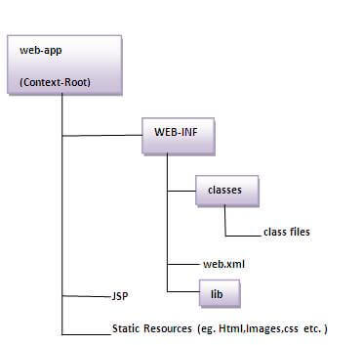
Web Developement
The Directory structure of JSP:
-The directory structure of JSP page is same as Servlet. -We contain the JSP page outside the WEB-INF folder or in any directory.

Slide 9
Web Developement
JSP and Servlets difference:
Servlet | JSP
Servlets are faster as compared to JSP, as they have a short response time. | JSP is slower than Servlets, as the first step in the JSP lifecycle is the conversion of JSP to Java code and then the compilation of the code.
Servlets are Java-based codes. | JSP are HTML-based codes.
Servlets are harder to code, as here, the HTML codes are written in Java. | JSPs are easier to code, as here Java is coded in HTML.
In an MVC architecture, Servlets act as the controllers. | In MVC architectures, the JSPs act as a view to present the output to the users.
It does not have inbuilt implicit objects. | In JSP there are inbuilt implicit objects.
There is no method for running JavaScript on the client side in Servlet. | While running the JavaScript at the client side in JSP, client-side validation is used.
Packages are to be imported on the top of the program. | Packages can be imported into the JSP prog(i.e,bottom, middleclient-side,or top )
The facility of writing custom tags is not present. | The facility of writing custom tags is present

Slide 10
Web Developement
How to Run a JSP Program in Apache Tomcat (Windows):
-A Java Server Page, or JSP, program is a crucial part of a Java web application because the JSP will send a response back to the server in the form of a web page.
-For example, a JSP might display the line items of an order to the browser user.
-In this topic, you will create a very simple JSP and learn how to run the program at the Tomcat server.
-To learn how to run a JSP in Apache Tomcat in a Windows environment, follow these 7 steps:
In your text editor, you will develop a simple JSP that creates a web page to display the current date. Type in the following statements in a new file:

Slide 11
Web Developement
How to Run a JSP Program in Apache Tomcat (Windows):
In your text editor, you will develop a simple JSP that creates a web page to display the current date. Type in the following statements in a new file:
<%@ page language="java" contentType="text/html"%>
<%@ page import="java.text.*,java.util.*" %>
<html>
<head>
<title>Date JSP</title>
</head>
<% SimpleDateFormat sdf=new SimpleDateFormat("MM/dd/yyyy"); %>
<body> <h1>Welcome to Tomcat! Today is </h1> </body> </html>

Slide 12
Web Developement
How to Run a JSP Program in Apache Tomcat (Windows):
The program contains <%@ tags that provide metadata about the JSP and import directives.
The JSP also contains HTML tags that will be rendered by the browser in the usual way.
Note the <% tags that encapsulate Java code.
The snippets of Java code are referred to as "scriplets."
When the JSP is requested by the browser, the program will be converted into a servlet by a program in the Tomcat container (Jasper) and the HTML output will be sent to the browser.

Slide 13
Web Developement
How to Run a JSP Program in Apache Tomcat (Windows):
2. Save your file as DateJSP.jsp
3. Copy your file to CATALINA_HOME/webapps/ROOT, e.g., c:/Tomcat8/webapps/ROOT.
Start the Tomcat server.
Start your browser if it is not already running.
In the address area of the browser, type http://localhost:8080/DateJSP.jsp and submit that address to the browser.

Slide 14
Web Developement
JavaBean Properties:
-A JavaBean property can be accessed by the user of the object. -The feature can be of any Java data type, containing the classes that you define.
It may be of the following mode: read, write, read-only, or write-only.
-A JavaBean property is a named feature that can be accessed by the user of the object.
-The feature can be of any Java data type, containing the classes that you define.
-A JavaBean property may be read, write, read-only, or write-only.
JavaBean features are accessed through two methods in the JavaBean's implementation class:
.

Slide 15
Web Developement
JavaBean Properties:
1. getPropertyName ()
For example, if the property name is firstName, the method name would be getFirstName() to read that property. This method is called the accessor.
2. setPropertyName ()
For example, if the property name is firstName, the method name would be setFirstName() to write that property. This method is called the mutator.
.

Slide 16
Web Developement
Advantages of JavaBean
The following are the advantages of JavaBean:
The JavaBean properties and methods can be exposed to another application.
It provides an easiness to reuse the software components.
Disadvantages of JavaBean:
JavaBeans are mutable. So, it can't take advantages of immutable objects.
Creating the setter and getter method for each property separately may lead to the boilerplate code.
.

Slide 17
Web Developement
Struts -A Struts in Java is an open-source framework that is made by Apache.
-It enables you to create maintainable, extensible, and flexible web applications based on standard technologies, such as JSP pages, JavaBeans, resource bundles, and XML.
Apache provides a free source to download Struts for users. It follows the MVC (Model View Controller) pattern.
It provides an implementation of MVC architecture. It gives us pre-built classes for MVC that we can use/extend. Struts have their custom tag libraries.
Struts in Java are used to develop web applications which are usually based on servlet and JSP.
It simplifies the development and maintenance of web applications by providing predefined functionality.
It is based on a front controller, which means it has a controller in front of it which decides on which model request has to come or go.

Slide 18
Web Developement
Struts in Java are very helpful for us as MVC is a guideline followed by all technologies in today’s world. There is no better option to simplify web applications other than MVC. Struts are not distributed.
There are two versions of struts- 1.x(1.0,1.1,1.2) 2.x(2.0,2.1,2.2) 1. The first version of struts is rarely used by companies.
Most companies prefer the second version of it
The second version of struts includes additional features.
In struts 1.x uses servlet based controllers, but in struts 2.x, uses filter based controllers
.

Slide 19
Web Developement
Struts 1.x 1. Server side validation 2. Form backup Support 3. Exception Handling 4. Modularization 5. Multi button 6. Tiles Support 7. Plug-in support
Struts 2.x 1.It is a brand new framework by Apache software foundation.
The following facilities are available in struts 1. Filter based controller 2.It uses both XML files and annotations for configuration. 3. It also supports zero configuration web application. 4. It also implements AOP(Aspect Oriented Programming) for cross-cutting tasks with the help of interceptors.

Slide 20
Web Developement
Components of Struts in Java There are many components of struts. They are as follows-
Filter Dispatcher 2. Action 3. Result 4.Configuration file 5. Interceptors 6. Deployment descriptor 7. Tag Library
.

Slide 21
Web Developement
1. Filter Dispatcher
It is the controller component of Struts application. From a coding point of view, the controller is represented by org.Apache.Struts2.filtered patcher class, which is just a filter class.
A controller component is responsible for each incoming request and identifies appropriate actions to process the request at outer processing. The request is also responsible for identifying appropriate views to display the result with the help of the result component.
2. Action
In Struts 2, the functionality of the model is represented by the action component. From a coding point of view, an action is represented by a bean class containing the state of an application and any business logic. This component is developed by the programmer. An Action is a model in Struts 2 which is used to handle all the data.

Slide 22
Web Developement
3. Result
The result means view. In the Struts2 application, the functionality of view is managed by the result component. That is, the result component is responsible for the presentation logic of the Struts application.
A result is responsible for identifying JSP pages to display the results.
4. Configuration file
Struts 2 uses a configuration file to describe the action, result and other resources. The name of this file is — struts.xml.
5. Interceptors
Interceptors are the helper components of the controller and are responsible for applying cross-cutting concerns or other commonly used logics. Wherever we want to use the logic in JSP or servlet, we use interceptors. There are many interceptors in Struts.

Slide 23
Web Developement
6. Deployment Descriptor
This is the deployment descriptor of the Struts Application and contains the information about controller web.xml. All information gathered in the deployment descriptor, which is used in MVC. It stores information about how many JSP and servlets used in this application. Basically, it is the XML file.
7. Tag Library
Struts 2 provides a custom tag library to develop JSP pages and to manipulate the data. The user can design the form or text using the tag library. First, we make the tag directive in this library.

Slide 24
Web Developement
Structure of Struts.XML file
Struts is the root element of these files. Packages are the sub element of Struts that defines the set of actions and results.
<struts>
<constant name = "struts.devMode" value = "true" />
<package name = "helloworld" extends = "struts-default">
<action name = "hello"
class = "hello.struts2.HelloWorldAction"
method = "execute">
<result name = "success">/HelloWorld.jsp</result>
</action>
<-- more actions can be listed here -->
</package>
<-- more packages can be listed here -->
</struts>

Slide 25
Web Developement
There are some automatic features of Struts 2:
Param transfer to member variables.
Validation
It is easy to learn as it is very simple.
It provides good tag libraries.
It supports many convenient features.
It is extensible.
It is also flexible.
It is very well integrated with J2EE.

Slide 26
Web Developement
Struts Configuration:
Introduction:
-Configuration files represent the actual working of any application.
-They show the basic initial settings for running any executable.
-A program before executing, consults the configuration files for the actual flow of working.
-The struts application contains two main configuration files struts.xml file and struts.properties file.

Slide 27
Web Developement
struts.xml
<?xml version="1.0" encoding="UTF-8" ?>
<!DOCTYPE struts PUBLIC "-//Apache Software Foundation//DTD Struts
Configuration 2.1//EN" "http://struts.apache.org/dtds/struts-2.1.dtd">
<struts>
<package name="default" extends="struts-default">
<action name="product" class="com.javatpoint.Product">
<result name="success">welcome.jsp</result>
</action>
</package>
</struts>

Slide 28
Web Developement
1) package element:
We can easily divide our struts application into sub modules. The package element specifies a module. You can have one or more packages in the struts.xml file.
Attributes of package element:
name name is must for defining any package.
namespace It is an optional attribute of package. If namespace is not present, / is assumed as the default namespace.
In such case, to invoke the action class, you need this URL:
/actionName.action
3. extends The package element mostly extends the struts-default package where interceptors and result types are defined. If you extend struts-default, all the actions of this package can use the interceptors and result-types defined in the struts-default.xml file.

Slide 29
Web Developement
2) action element:
The action is the sub element of package and represents an action.
Attributes of action element
name name is must for defining any action.
class class is the optional attribute of action. If you omit the class attribute, ActionSupport will be considered as the default action. A simple action may be as:
<action name="product">
3. method It is an optional attribute. If you don't specify method attribute, execute method will be considered as the method of action class.
So this code:
<action name="product" class="com.javatpoint.Product">
If you want to invoke a particular method of the action, you need to use method attribute.

Slide 30
Web Developement
3) result element
It is the sub element of action that specifies where to forward the request for this action.
Attributes of result element
1. name is the optional attribute. If you omit the name attribute, success is assumed as the default result name.
2. type is the optional attribute. If you omit the type attribute, dispatcher is assumed as the default result type.

Slide 31
Web Developement
Struts Actions:
-Actions are the core of the Struts2 framework, as they are for any MVC (Model View Controller) framework.
-Each URL is mapped to a specific action, which provides the processing logic which is necessary to service the request from the user.
*But the action also serves in two other important capacities.
- Firstly, the action plays an important role in the transfer of data from the request through to the view, whether its a JSP or other type of result.
Secondly, the action must assist the framework in determining which result should render the view that will be returned in the response to the request.

Slide 32
Web Developement
Action Interface
-A convenient approach is to implement the com.opensymphony.xwork2.Action interface that defines 5 constants and one execute method.
-5 Constants of Action Interface
-Action interface provides 5 constants that can be returned form the action class. They are:
SUCCESS indicates that action execution is successful and a success result should be shown to the user.
ERROR indicates that action execution is failed and a error result should be shown to the user.
LOGIN indicates that user is not logged-in and a login result should be shown to the user.
INPUT indicates that validation is failed and a input result should be shown to the user again.
NONE indicates that action execution is successful but no result should be shown to the user.

Slide 33
Web Developement
Let's see what values are assigned to these constants:
public static final String SUCCESS = "success";
public static final String ERROR = "error";
public static final String LOGIN = "login";
public static final String INPUT = "input";
public static final String NONE = "none";
ActionSupport class
-It is a convenient class that implements many interfaces such as Action, Validateable, ValidationAware, TextProvider, LocaleProvider and Serializable . So it is mostly used instead of Action.
-Example of Struts Action that extends ActionSupport class
-Let's see the example of Action class that extends the ActionSupport class.

Slide 34
Web Developement
Welcome.java
Package com.javatpoint;
import com.opensymphony.xwork2.ActionSupport;
public class Welcome extends ActionSupport{
public String execute(){
return SUCCESS;
}
}

Slide 35
Web Developement
Struts 2 Interceptor :
- Interceptor is an object that is invoked at the preprocessing and postprocessing of a request.
- In Struts 2, interceptor is used to perform operations such as validation, exception handling, internationalization, displaying intermediate result etc.
Advantage of interceptors
-Pluggable If we need to remove any concern such as validation, exception handling, logging etc. from the application, we don't need to redeploy the application.
-We only need to remove the entry from the struts.xml file.

Slide 36
Web Developement
Struts 2 default interceptors
There are many interceptors provided by struts 2 framework. We have option to create our own interceptors. The struts 2 default interceptors are as follows:
1) alias It converts similar parameters that have different names between requests.
2) autowiring
3) chain If it is used with chain result type, it makes the properties of previous action available in the current action.
4) checkbox It is used to handle the check boxes in the form. By this, we can detect the unchecked checkboxes.
5) cookie It adds a cookie to the current action.
6) conversionError It adds conversion errors to the action's field errors.
7) createSession It creates and HttpSession object if it doesn't exists.
8) clearSession It unbinds the HttpSession object.

Slide 37
Web Developement
9) debugging It provides support of debugging.
10) externalRef
11) execAndWait It sends an intermediate waiting page for the result.
12) exception It maps exception to a result.
13) fileUpload It provides support to file upload in struts 2.
14) i18n It provides support to internationalization and localization.
15) jsonValidation It provides support to asynchronous validation.
16) logger It outputs the action name.
17) store It stores and retrieves action messages, action errors or field errors for action that implements ValidationAware interface.
18) modelDriven It makes other model object as the default object of valuestack.
19) scopedModelDriven It is similar to ModelDriven but works for action that implements ScopedModelDriven.

Slide 38
Web Developement
19) scopedModelDriven It is similar to ModelDriven but works for action that implements ScopedModelDriven.
20) params It populates the action properties with the request parameters.
21) actionMappingParams
22) prepare It performs preparation logic if action implements Preparable interface.
23) profiling It supports action profiling.
24) roles It supports role-based action.
25) scope It is used to store the action state in the session or application scope.
26) servletConfig It provides access to maps representing HttpServletRequest and HttpServletResponse.
27) sessionAutowiring
28) staticParams It maps static properties to action properties.
29) timer It outputs the time needed to execute an action.
30) token It prevents duplication submission of request.

Slide 39
Web Developement
32) validation It provides support to input validation.
33) workflow It calls the validate method of action class if action class implements Validateable interface.
34) annotationWorkflow
35) multiselect

Slide 40
Web Developement
result types in Structs:
-the <results> tag plays the role of a view in the Struts2 MVC framework.
-The action is responsible for executing the business logic.
-The next step after executing the business logic is to display the view using the <results> tag.
-Struts comes with a number of predefined result types .
-Struts allow you to use other markup languages for the view technology to present the results and popular choices include Velocity, Freemaker, XSLT and Tiles.
-Following are types of result types in Structs:
The Dispatcher Result Type
The FreeMaker Result Type

Slide 41
Web Developement
result types in Structs:
1) The Dispatcher Result Type:
The dispatcher result type is the default type, and is used if no other result type is specified. It's used to forward to a servlet, JSP, HTML page, and so on, on the server. It uses the RequestDispatcher.forward() method.
We can also specify the JSP file using a
<param name = "location"> tag within the <result...>
element as follows
<result name = "success" type = "dispatcher">
<param name = "location">
/HelloWorld.jsp
</param >
</result>
We can also supply a parse parameter, which is true by default. The parse parameter determines whether or not the location parameter will be parsed for OGNL expressions(Object-Graph Navigation Language; it is an expression language for getting and setting properties of Java objects).

Slide 42
Web Developement
2)The FreeMaker Result Type:
-In this example, we are going to see how we can use FreeMaker as the view technology.
-Freemaker is a popular templating engine that is used to generate output using predefined templates.
-login.jsp
<%@ taglib uri="/struts-tags" prefix="s"%>
<html>
<head> <title>Struts 2 freemarker result type example</title>
</head>
<body>
<h3>This is a freemarker result type example.</h3>
<s:form action="Login">
<s:textfield name="userName" label="UserName" />
<s:submit value="Hello" align="center"/> </s:form>
</body>
</html>

Slide 43
Web Developement
result types in Structs:
Next, let us modify the struts.xml to specify the result as follows :
<struts>
<constant name = "struts.devMode" value = "true" /> <package name = "helloworld" extends = "struts-default">
<action name = "hello" class = "com.tutorialspoint.struts2.HelloWorldAction" method = "execute">
<result name = "success" type = "freemarker">
<param name = "location">/hello.fm</param> </result>
</action>
</package>
</struts>

Slide 44
Web Developement
result types in Structs:
3) Redirect Result Type
-The redirect result type calls the standard response.sendRedirect() method, causing the browser to create a new request to the given location.
-We can provide the location either in the body of the <result...> element or as a <param name = "location"> element.
Redirect also supports the parse parameter. Here's an example configured using XML −
<action name = "hello" class = "com.tutorialspoint.struts2.HelloWorldAction" method = "execute">
<result name = "success" type = "redirect">
<param name = "location">
/NewWorld.jsp
</param >
</result> </action>
So just modify your struts.xml file to define redirect type as mentioned above and create a new file NewWorld.jpg where you will be redirected whenever hello action will return success

Slide 45
Web Developement
Exception handling IN struts:
-Struts provides an easy way for handling uncaught exceptions which might be thrown during execution of action classes.
-Uncaught exceptions are ones which are not caught by the regular try-catch clause. -There are two methods for handing uncaught exceptions in Struts:
1)Global exception handling: specifies exception mappings (exception type - view name) which apply to all action classes in a Struts package.
2)Exception handling per action: specifies exception mappings which apply to a specific action class.
-Both methods require adding exception mappings in struts.xml configuration file. Let’s go through each method in details

Slide 46
Web Developement
Global exception handling in Struts:
-Add the following code snippet just after the <package> element in struts.xml file:
<global-results>
<result name="error">/Error.jsp</result>
</global-results>
<global-exception-mappings>
<exception-mapping exception="java.lang.Exception" result="error"/>
</global-exception-mappings>
-The <global-results> element defines global view names. Here the view named “error” is mapped with the actual view page “/Error.jsp”.
-The <global-exception-mappings> element specifies a set of <exception-mapping> element which maps an exception type to a view name.
-Here the exception of type java.lang.Exception is mapped to the view name “error”.
-That means when any uncaught exception of type java.lang.
-Exception or its sub types is thrown, Struts will redirect users to the view page mapped with the name “error”.

Slide 47
Web Developement
Global exception handling in Struts:
In the Error.jsp page we can access information of the exception as follows:
Exception name: <s:property value="exception"/>
Exception stack trace: <s:property value="exceptionStack"/>

Slide 48
Web Developement
A complete example in action. Consider the following Struts action class:
package net.codejava.struts;
import javax.servlet.http.HttpServletRequest;
import org.apache.struts2.interceptor.ServletRequestAware;
import com.opensymphony.xwork2.ActionSupport;
public class SumAction extends ActionSupport implements ServletRequestAware {
private HttpServletRequest request;
private int sum;
public int getSum() {
return sum;
}
public String execute() {
// an exception might be thrown here if x/y is not a number
int x = Integer.parseInt(request.getParameter("x"));
int y = Integer.parseInt(request.getParameter("y"));
sum = x + y;
return SUCCESS;
}
@Override
public void setServletRequest(HttpServletRequest request) {
this.request = request;
}
}

Slide 49
Web Developement
-The execute() method parses two numbers x and y from the request and produces sum of both. In this case, an exception might be thrown if either x or y is not a number (a java.lang.NumberFormatException exception is raised).
Code of the Error.jsp page:
<%@ page language="java" contentType="text/html; charset=UTF-8"
pageEncoding="UTF-8"%>
<%@ taglib prefix="s" uri="/struts-tags" %>
<!DOCTYPE html PUBLIC "-//W3C//DTD HTML 4.01 Transitional//EN"
"http://www.w3.org/TR/html4/loose.dtd">
<html>
<head>
<meta http-equiv="Content-Type" content="text/html; charset=UTF-8">
<title>Error page</title>
</head>
<body>
<center>
<h1>Sorry, unexpected exception occurred:</h1>
<h2>Exception name: ${exception}</h2>
</center>
</body>
</html>

Slide 50
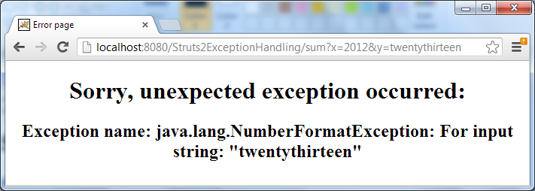
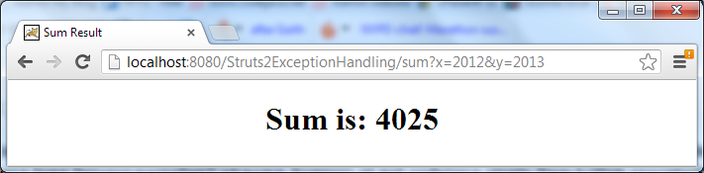
Web Developement
Code of the JSP page which will be displayed when the execute() method returns successfully (Sum.jsp):
*Action taken as per process.

Slide 51
Web Developement
Of course we can specify multiple exception mappings as follows:
<global-results>
<result name="error">/Error.jsp</result>
<result name="dbError">/DBError.jsp</result>
</global-results>
<global-exception-mappings>
<exception-mapping exception="java.lang.Exception" result="error"/>
<exception-mapping exception="java.sql.SQLException" result="dbError"/>
</global-exception-mappings>

Slide 52
Web Developement
2. Exception handling per action in Struts
This method specifies the <exception-mapping> elements inside the <action> element, for example:
<action name="connectDB" class="net.codejava.struts.ConnectDBAction">
<exception-mapping result="dbError" exception="java.sql.SQLException" />
<result name="success">/DBConnect.jsp</result>
<result name="dbError">/DBError.jsp</result>
</action>
-That tells Struts to redirect the users to the view “dbError” when an exception of type java.sql.
-SQLException (or its sub type) is thrown inside the action class ConnectDBAction.

Slide 53
Web Developement
Code of the error page (DBError.jsp):
<%@ page language="java" contentType="text/html; charset=UTF-8"
pageEncoding="UTF-8"%>
<!DOCTYPE html PUBLIC "-//W3C//DTD HTML 4.01 Transitional//EN"
"http://www.w3.org/TR/html4/loose.dtd">
<html>
<head>
<meta http-equiv="Content-Type" content="text/html; charset=UTF-8">
<title>Database Error page</title>
</head>
<body>
<center>
<h1>Sorry, a database exception occurred:</h1>
<h2>Exception name: ${exception}</h2>
</center>
</body>
</html>

Slide 54
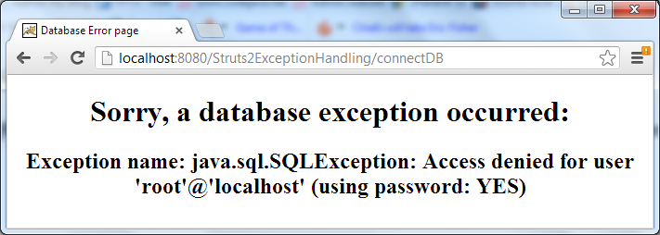
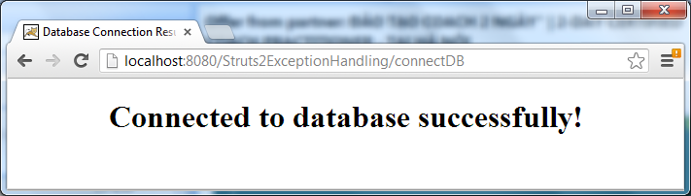
Web Developement
Error Messages:
NOTE: If a same exception mapping is declared both globally and per action, then the action-specific exception mapping will take precedence.

Slide 55
Web Developement
Different Annotations are present in Struts2, shown below:
Annotations | Description
@Result | Single results is given using the result annotation. It provides the output in the action class.
@Action | Defines the URL for the action class, and the class identification is made by action annotation.
@Namespace | The part of the action URL between the context path and the action name, as indicated by namespace annotation, should be specified.
@RequiredFieldValidator | It checks that the field is not null. It is applied at the method level.are
@BeforeResult | It is used to call the method before the result is called.
@After | It calls the action method after the primary method and when the outcome is executed.
@Results | It defines the set of results.
@EmailValidator | This annotation checks for the email address's validity and contains an empty string.
@RequiredStringValidator | It checks that the string is not null and has a length > 0.
@TypeConversion | It is applicable at the property and method levels.

Slide 56
Web Developement
Annotations | Description
@ConversionErrorFieldValidator Annotation | This annotation checks for validation in a field and conversion mistakes and fix them.
@KeyProperty | Sets the key property for type conversion.
@BeforeResult | This makes the action class execute the method before the result is out.
@DateRangeFieldValidator | It checks whether the date field is in the range or not.

Slide 57
Web Developement
Some of the popularly used annotations are shown in the code below.
1) @Results Annotation
It defines the multiple results for a single action. When the class has multiple values to return, we use results annotations so that you can receive the value that is returned by the method.
@Results({
@Result(name = "success", value = "/success.jsp"),
@Result(name = "error", value = "/error.jsp")
})
public class DemoAction extends ActionSupport{
...
}

Slide 58
Web Developement
2) @Result Annotation:
It defines the result for a single unit. We use the annotation result when the action class returns a single value. The above method gives you the ease that you can receive the returned value of the class.
@namespace(“/demo”)
@Result(name = SUCCESS, location = "/WEB-INF/views/demo/index.jsp")
public class DemoAction extends ActionSupport {….}

Slide 59
Web Developement
Web Services:
- The World Wide Web Consortium (W3C) defines “web of services” as “message-based design frequently found on the Web and in enterprise software”.
Basically, a web service is a method of sending a message between two devices through a network.
Web services have been adopted so quickly because they bring several important advantages:
Allow communication and interoperability between applications running on different platforms and built with different technologies
Enable different applications to share common standard formats and representations
Can be reused by many different types of applications
Are loosely coupled with other services
Allow flexibility in choosing the functionalities you need

Slide 60
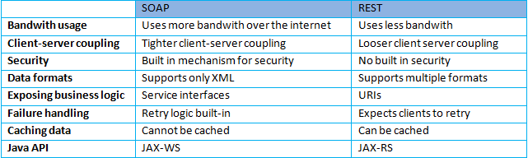
Web Developement
There are two primary types of web services:
SOAP (Simple Object Access Protocol) and
REST (REpresentational State Transfer) services; the latter is more recent and more widely used today.
Summary of the main differences between the two standards:

Slide 61
Web Developement
Create Webservice in Java:
Here we will use Eclipse IDE for this. You just need to follow step by step as mentioned below with screenshots to create a simple web service in java.
Step 1: Open eclipse >
On the server tab, add one server (here I am using tomcat) in which you will run your web services.
Step 2: Right-click on server tab> New> Server> Select Apache tomcat 6> Finish.
After that, you can see the server is created in the “Stopped” state; we will start the servers before running our application.
Now we will start our server.
Step 3: Right-click on tomcat > start
Create web services in Java 5
Now we will open project explorer for java EE.
Step 4: Click on restore > you will see project explorer
Create web services in Java 6

Slide 62
Web Developement
Now we will create our web service.
Step 5: File>New>Dynamic Web Project
Create web services in Java 7
Could you give it a name (here, WebAdder)? Follow the below picture and do exactly the same as what is in there.
Step 6: Click on next> Finish
Create web services in Java

